Slide 1
Data Modeling
Module-03

Slide 2
Contents
Introduction to the Type System
Collections & Relations
Deployment

Slide 3
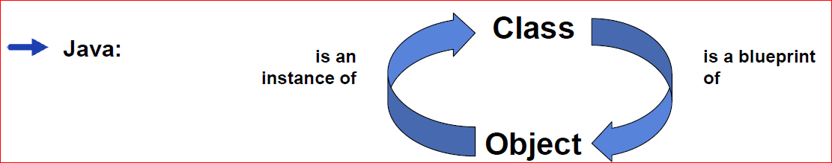
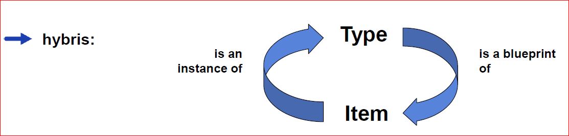
hybris and Java

Slide 4
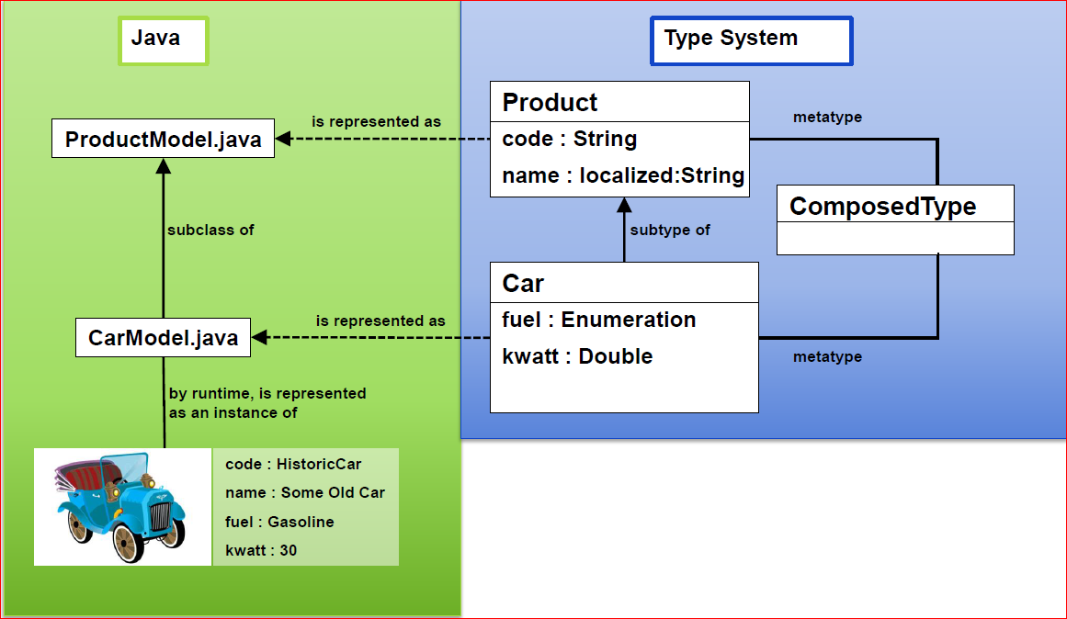
Java Classes vs hybris Types

Slide 5
Types used in hybris
Atomic Type
Represents Java value objects which are mapped to database types
Java Primitives: int
Wrapper: Integer
Some Reference types: java.util.Date
Collection Type
Represents a typed collection
Map Type
Represents a typed Map

Slide 6
Types used in hybris
Composed Type
Composed object of other hybris types
Java Primitives: int
Wrapper: Integer
Some Reference types: java.util.Date
EnumerationMeta Type
Composed Type which describes enumerations
Relation Type
Composed Type which describes binary relations between items

Slide 7
Extending the Data Model
Create new types:
Define a type by extending already existing types, such as:
<itemtype code="Car" extends="Product">
Define “completely new types”, such as:
<itemtype code="Car" >
(implicitly extends from GenericItem)
Extend existing types:
Add attribute definitions to existing types (attribute injection), such as:
<itemtype code="Product" …>
...
<attribute qualifier="MyAttribute">
</itemtype>
Redefine inherited attribute definitions from super type
<attribute qualifier="code" redeclare="true">
If you change the attribute's java type, the new type must extend the original type

Slide 8
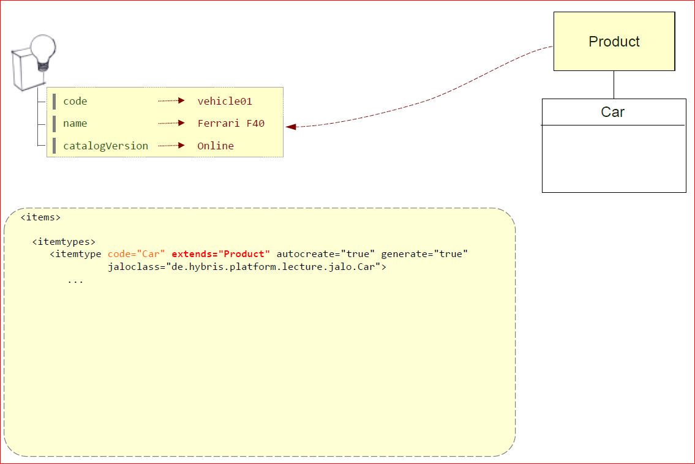
hybris Type System • Extending

Slide 9
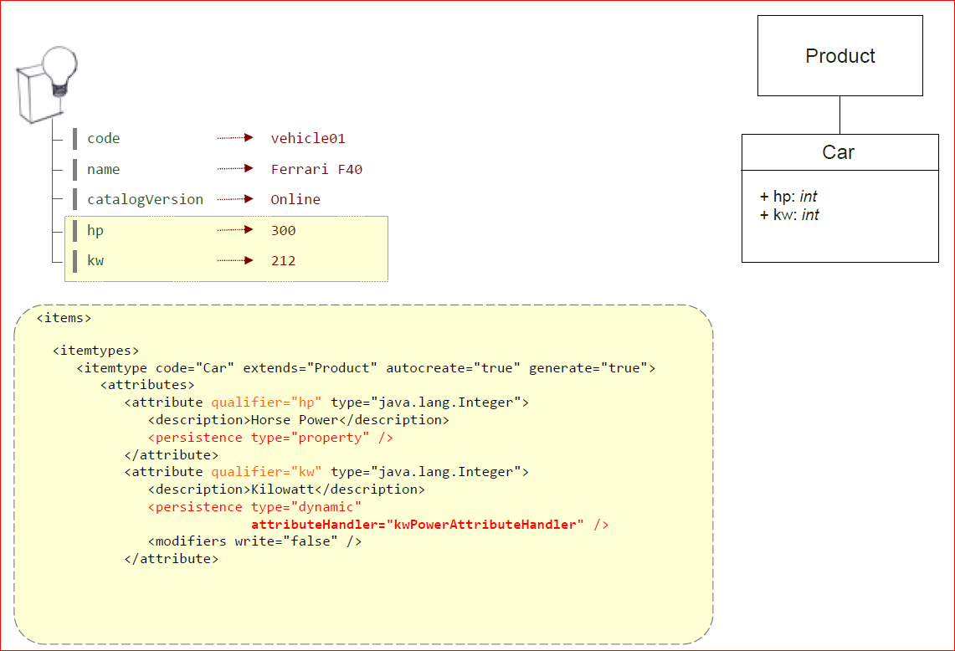
hybris Type System • Attributes

Slide 10
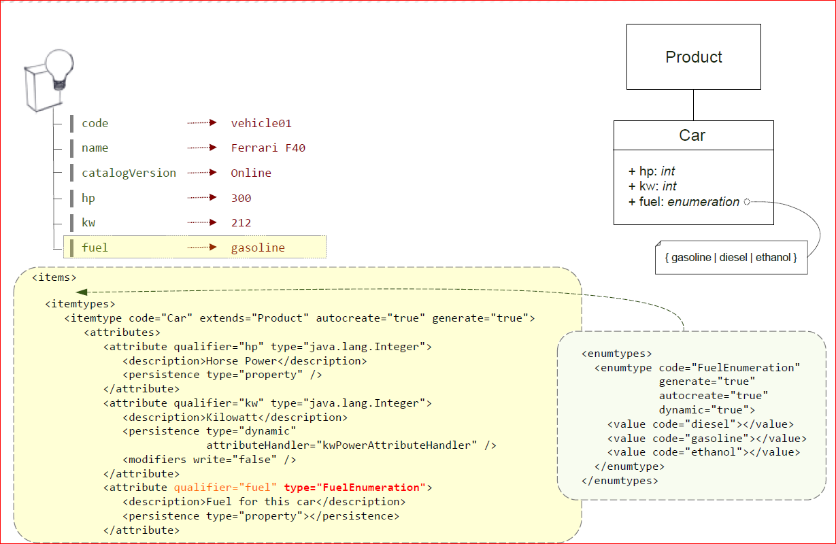
hybris Type System • Enumerated types

Slide 11
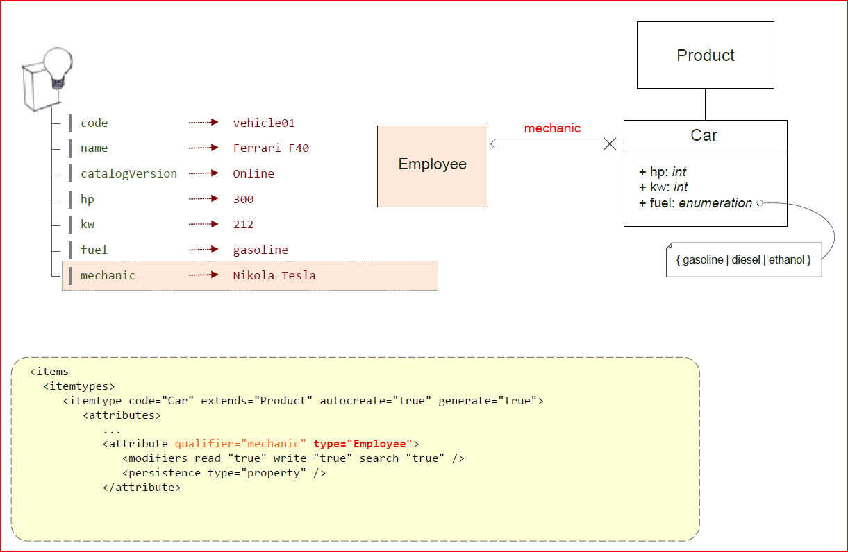
hybris Type System • Composed type reference

Slide 12
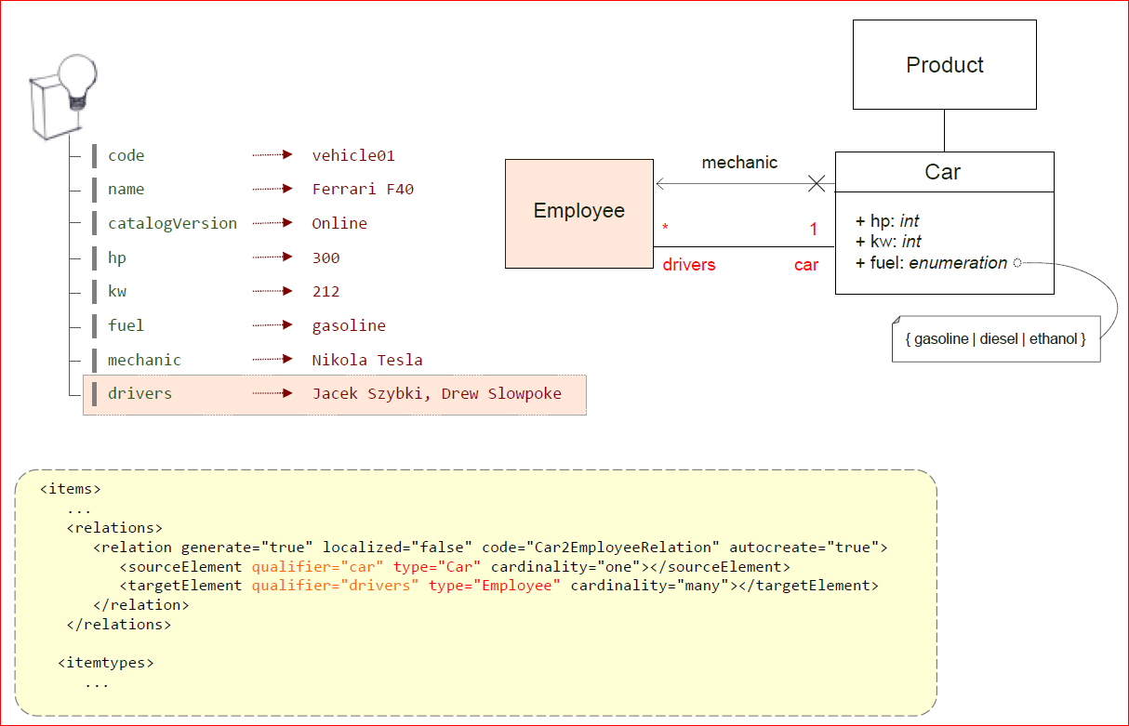
hybris Type System • Relations

Slide 13
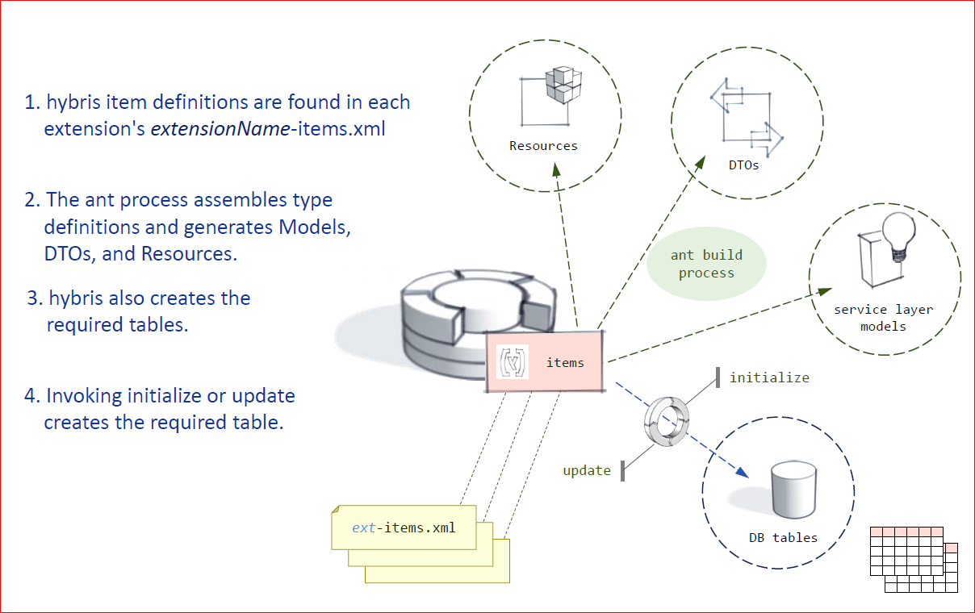
hybris Type System • Autometic Generation

Slide 14
Quizees
1.What is the equivalent of a Java object in hybris?
2.What is the difference between a composed type and an atomic type in hybris?
3.What file is used to configure types in hybris?
4.In hybris, can you create new types, or only extend existing types?
5.Do you have to define a model-class in Java after defining it in xml?

Slide 15
Contents
Introduction to the Type System
Collections & Relations
Deployment

Slide 16
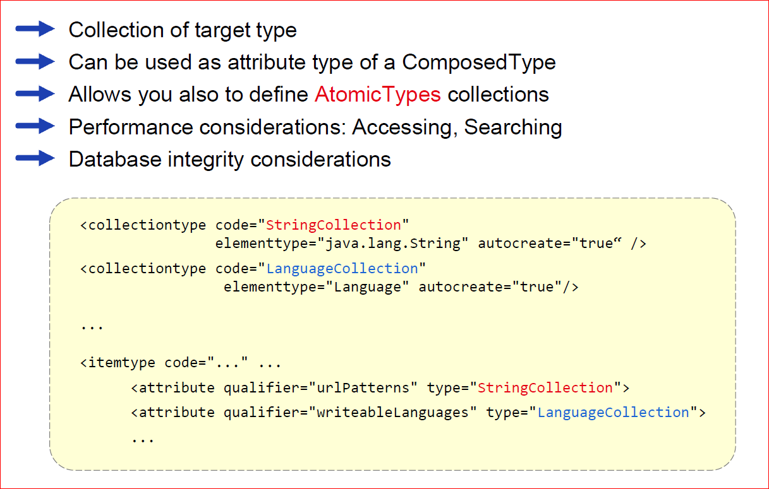
Collectiontypes

Slide 17
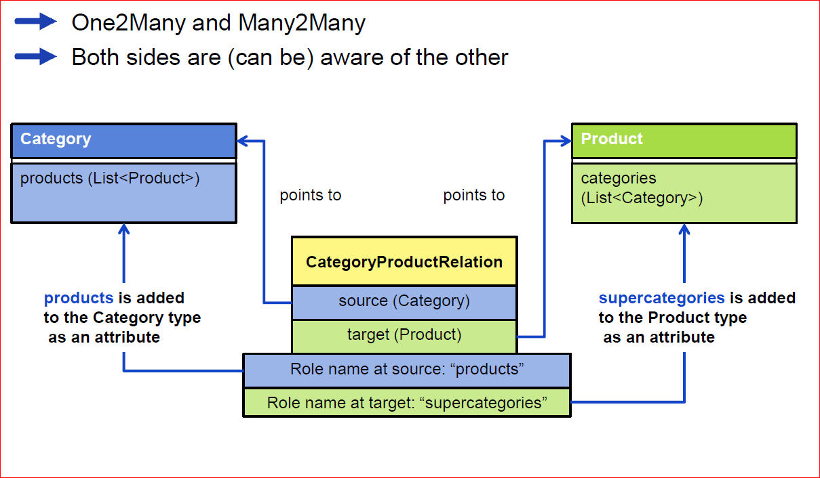
Relations

Slide 18
What’s so Important About Relations?
If in doubt: Use relations, not CollectionTypes, because:
Opposite side is not “aware” of the CollectionType
CollectionTypes are stored in a database field as a comma-separated list of references (PKs) or atomic values
Can cause overflow
More difficult to search and generally lower performance

Slide 19
Contents
Introduction to the Type System
Collections & Relations
Deployment

Slide 20
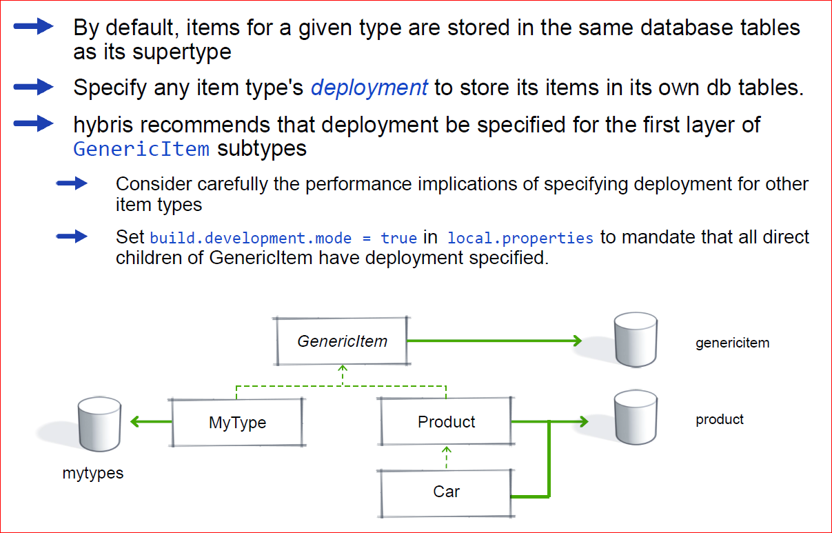
Object Relational Mapping — Storing objects in the DB

Slide 21
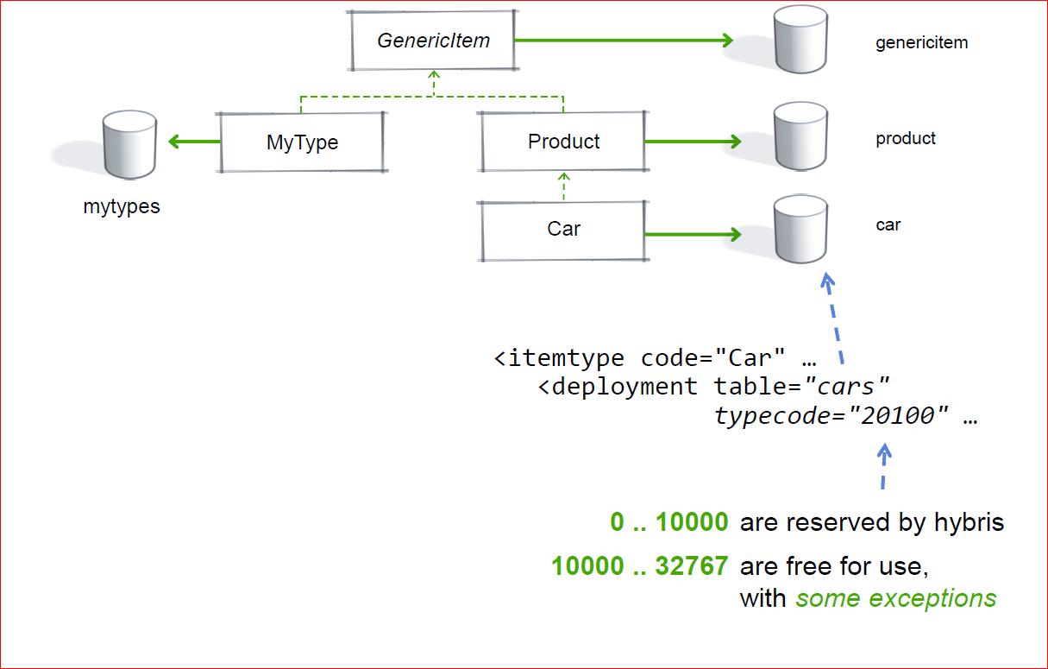
O-R Mapping – Deployment Example

Slide 22
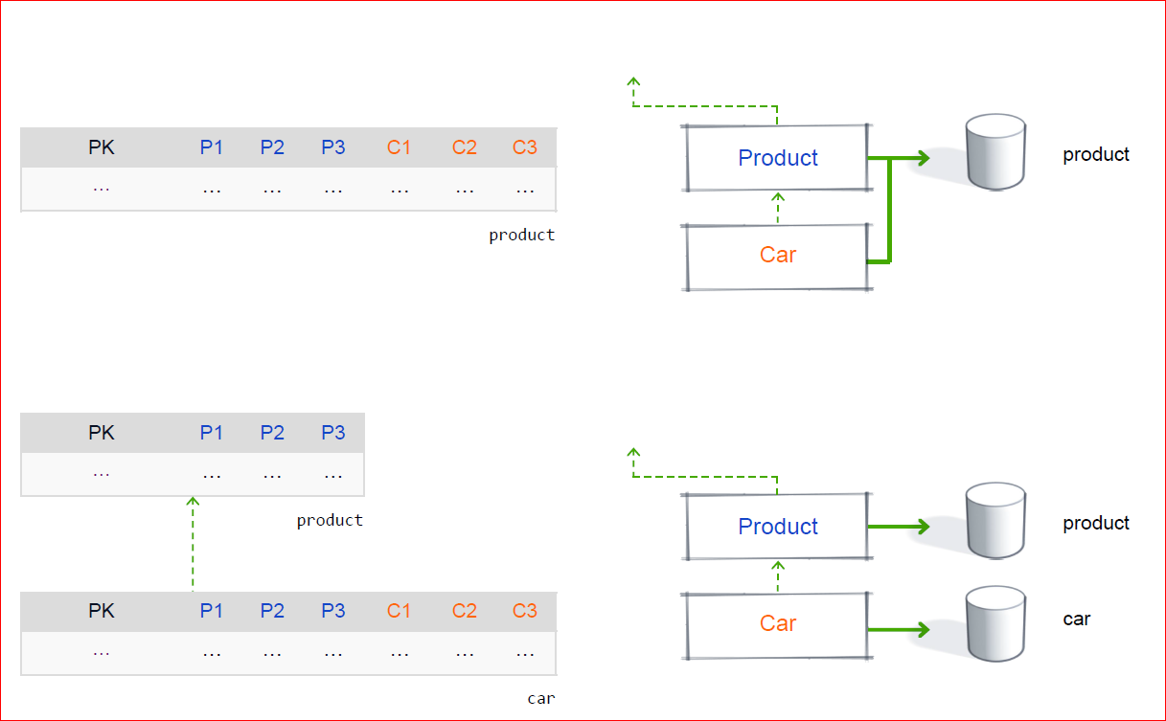
O-R Mapping – Table Structure

Slide 23
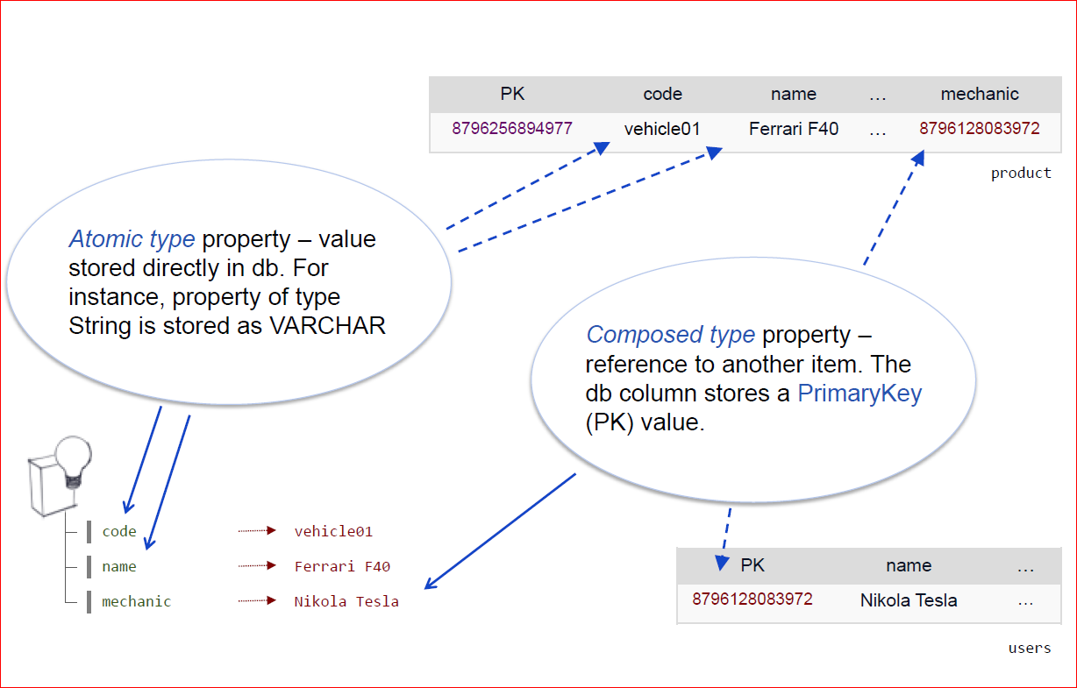
O-R Mapping – Attributes of a (Composed) Type

Slide 24
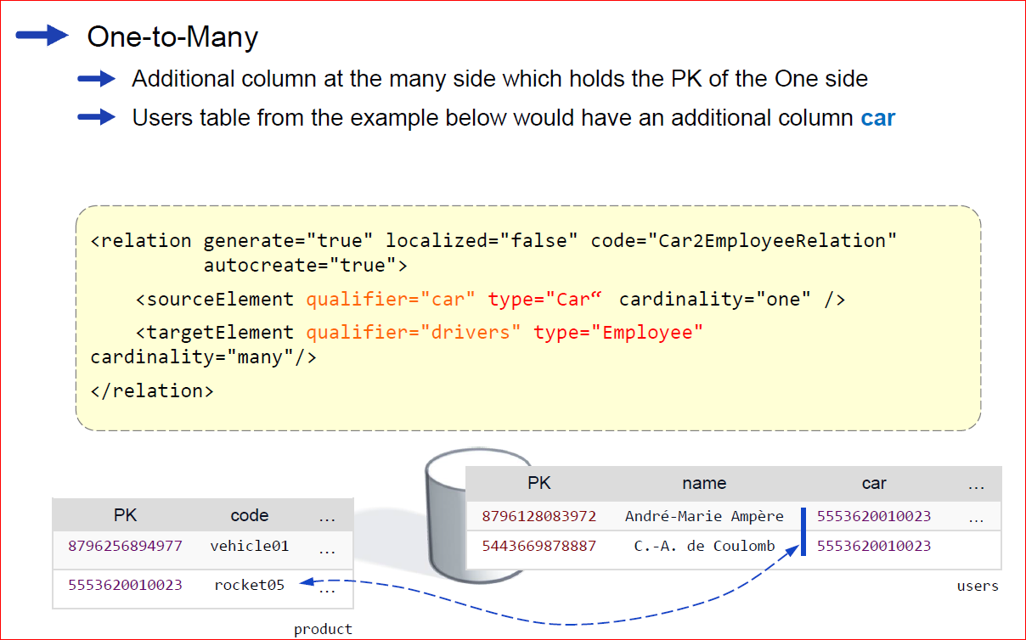
O-R Mapping – Deployment of Relations : 1

Slide 25
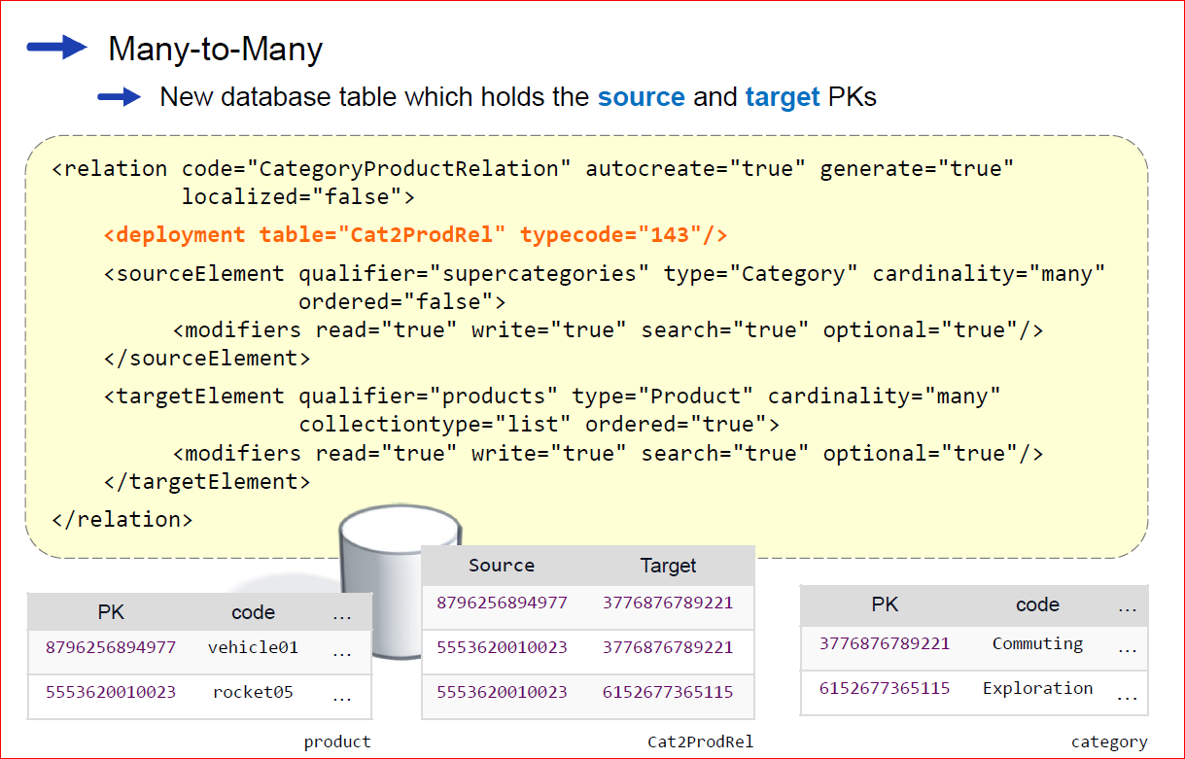
O-R Mapping – Deployment of Relations : 2

Slide 26
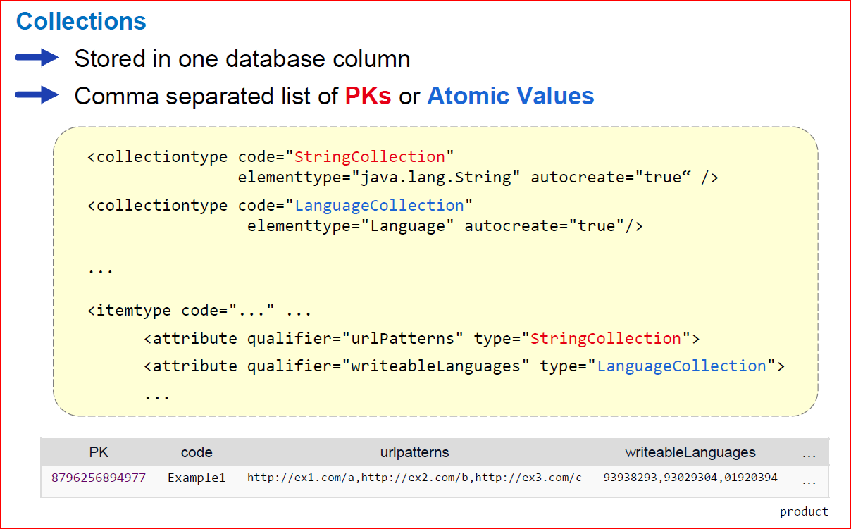
O-R Mapping – Deployment of Collections

Slide 27
Quizees
1.Name the two ways to model a collection in hybris
2.How are collection types stored in the database?
3.Specify some advantages and disadvantages of collection types
4.Explain the notion of deployment in hybris. When should you use it?

